Slide 1

Public Key Infrastructure (PKI) and Authentication
Jeff Chase
Duke University

Slide 2
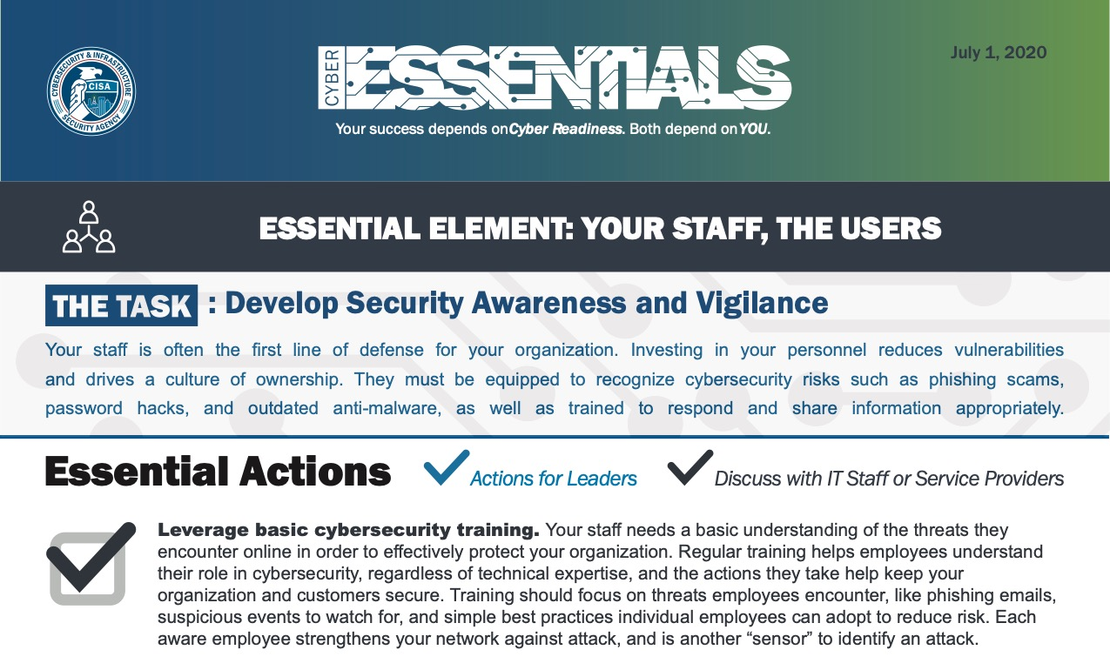

(US DHS)

Slide 3





Mallory-in-the-Middle attack
request
request
“GET fish.gif…”
“GET fish.gif …”
reply
reply
client (initiator)
server
If an attacker can interpose between two interacting entities, she can read and modify the messages at will without detection by either victim. How? By phishing or spoofing.
Classically a Man-in-the-Middle attack.

Slide 4

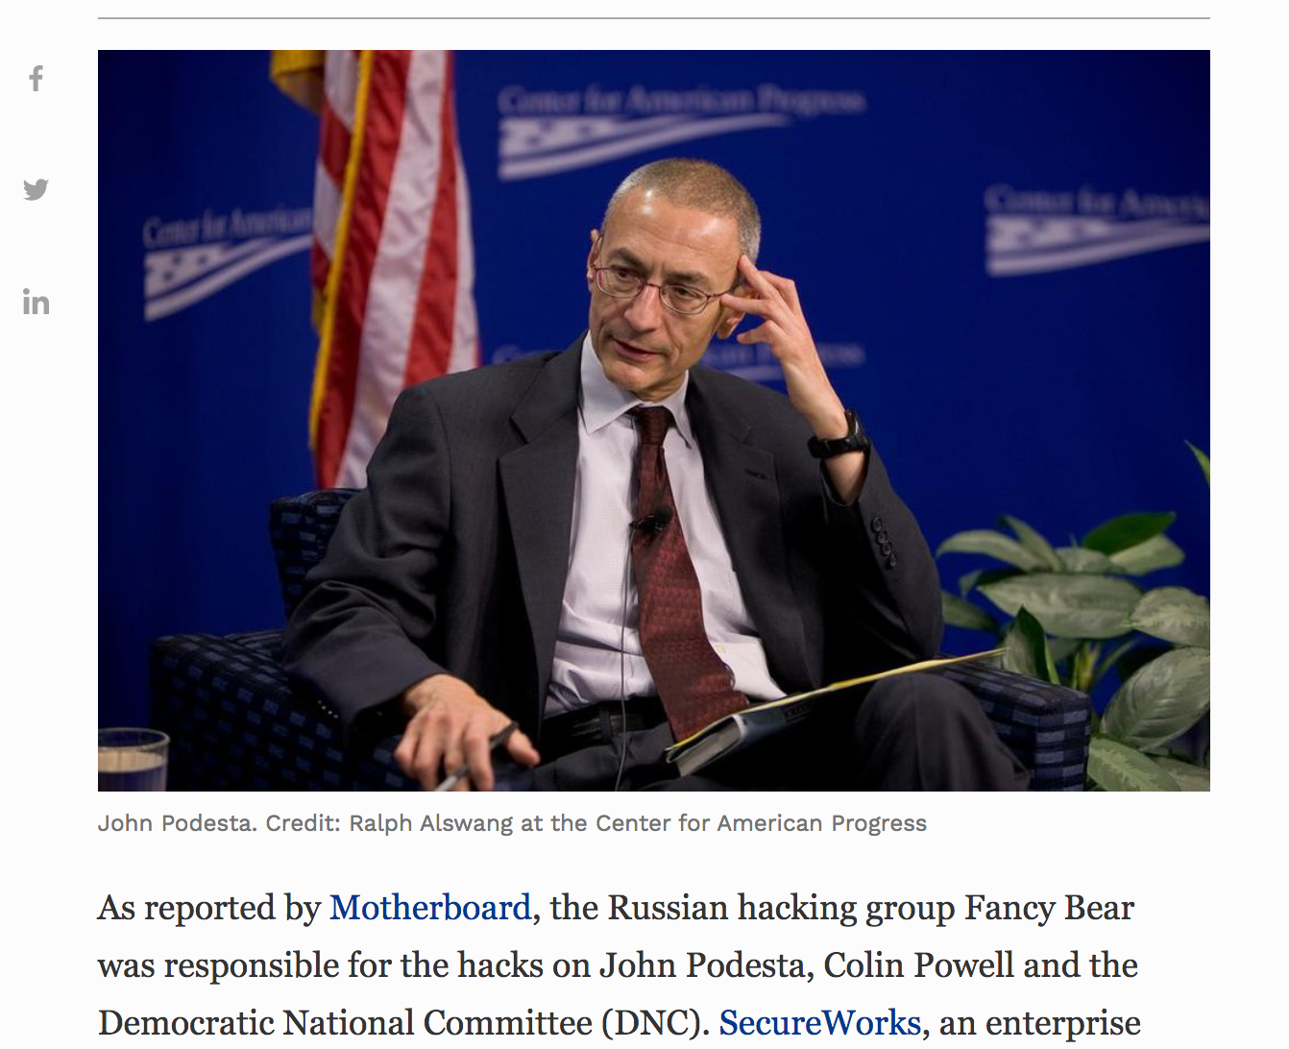
12,245 views Oct 21, 2016, 03:39am
How John Podesta's Emails Were Hacked And How To Prevent It From Happening To You

Slide 5
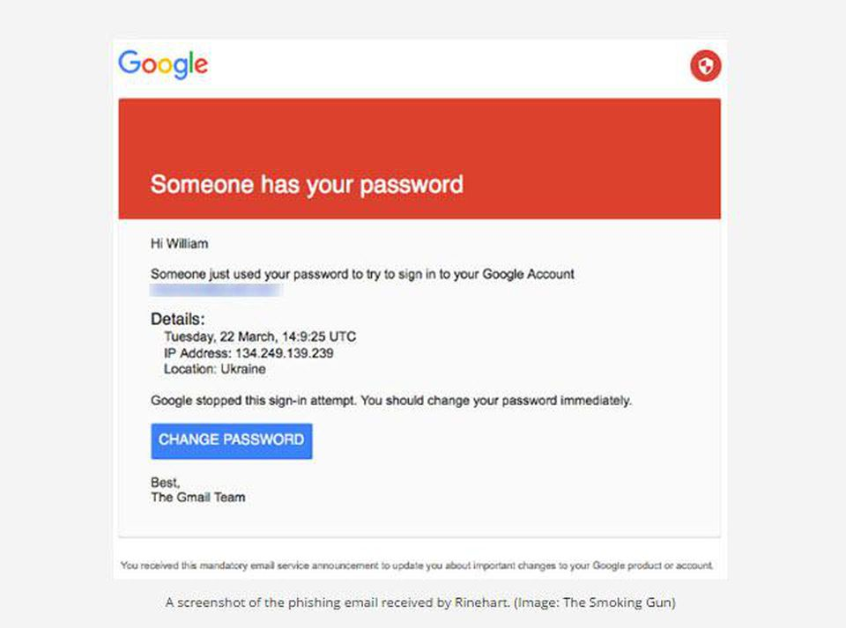

Slide 6
Hijacking a connection
client (initiator)
Spoofing. The adversary M “takes over” (spoofs) a network name to redirect the connection request to a computer that M controls. Many variants (e.g., pharming).
sd = socket(…);
connect(sd, name);
…
For the connect and bind system calls, the name is an IP address. To get it, the client may first call Domain Name Service to lookup a server DNS name (e.g., www.cs.duke.edu). This step may be vulnerable. E.g., home users get DNS service via vulnerable wireless routers.

Slide 7
MITM: Spelling it out
Malice in the Middle is a problem of authentication.
C believes C connects to S. False! C connects to M.
By phishing, e.g., C clicks a link provided by M that “looks like” a link for S but instead connects to M.
By spoofing: M attacks network to hijack name of S.
M masquerades as S to C to conceal the attack.
M fetches content from S and presents it to C.
→ M “looks like” S to C. C lacks means to verify S.
The problem is social (C is ignorant/careless) and also technical: how can C authenticate S?

Slide 8

End-to-end security: HTTPS
https://www.shop.com/shop.html
How to authenticate shop.com?
How to assure integrity/privacy of communications, even if the net is insecure? How to defeat MITM attacks?
Answer: Secure Sockets (SSL) or Transport-Layer Security (TLS), e.g., as used by Secure HTTP (HTTPS).
We call it end-to-end because it does not rely on trust in the network. Instead, server presents a credential and the client (the browser) verifies it directly.

Slide 9
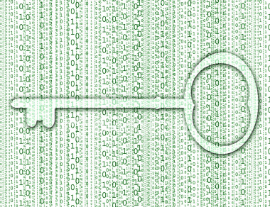



Crypto primitives
Encrypt/Decrypt
Use a shared secret key
(symmetric)
or
use a keypair
one public, one private
(asymmetric)
Signing
Secure hashing
useful for
fingerprinting data

Slide 10

TLS or HTTPS Cartoonishly Oversimplified, Version 1
Secure Sockets Layer (SSL) or Transport-Layer Security (TLS), used in HTTPS (Secure HTTP), SSH, SCP, etc.
“TCP SYN, etc.”
“My public key is K.”
“Encrypted secrets: {P}_{K} .”
Client
Server
[decrypts with private key]
[comms encrypted with shared secret]
…
Safe?

Slide 11
Mal-in-the-Middle attack: oops
1. “I am server, my key pub is K_{S}.”
2. “I am server, my pub key is K_{M}.”
3. “Hi server, I am client. Here is our secret: {P}_{KM}.”
client
server
4. “Hi server, I am client. Here is our secret: {P}_{KS}.”
How does C know that K is really the public key of S? How to authenticate that the sender is the correct server, e.g., gmail.com?

Slide 12



Finding the key
If either Alice or Bob knows the other’s public key, they can share any secret. But how to know?
This the public key distribution problem.
Common approach: a trusted intermediary endorses or certifies a key as belonging to a particular principal.
Such services are Public Key Infrastructure (PKI).
Alice,
Will you marry me?
Signed, Bob

Slide 13
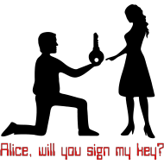
Endorsements: certificates
A principal may endorse another’s key.
How? Issue a document containing the key, and some statement about the key or the key holder (subject).
We call it a certificate for the subject: “like a photo ID”.
But how to validate the certificate?
Answer: issuer signs certificate with a digital signature.
Certificate
Term of validity
Issuer’s name (or key)
Bob’s key is 247E6F1A…
Signature

Slide 14

How does C know the public key of S?
In the HTTPS (SSL/TLS) example, S passes its public key to the client C. But how can C believe it?
Answer: some public authority (a Certifying Authority or CA) endorses the key by issuing a certificate for S. S sends the certificate: C’s browser verifies it, and matches the certificate’s Subject Name against the domain name in the URL.

Slide 15
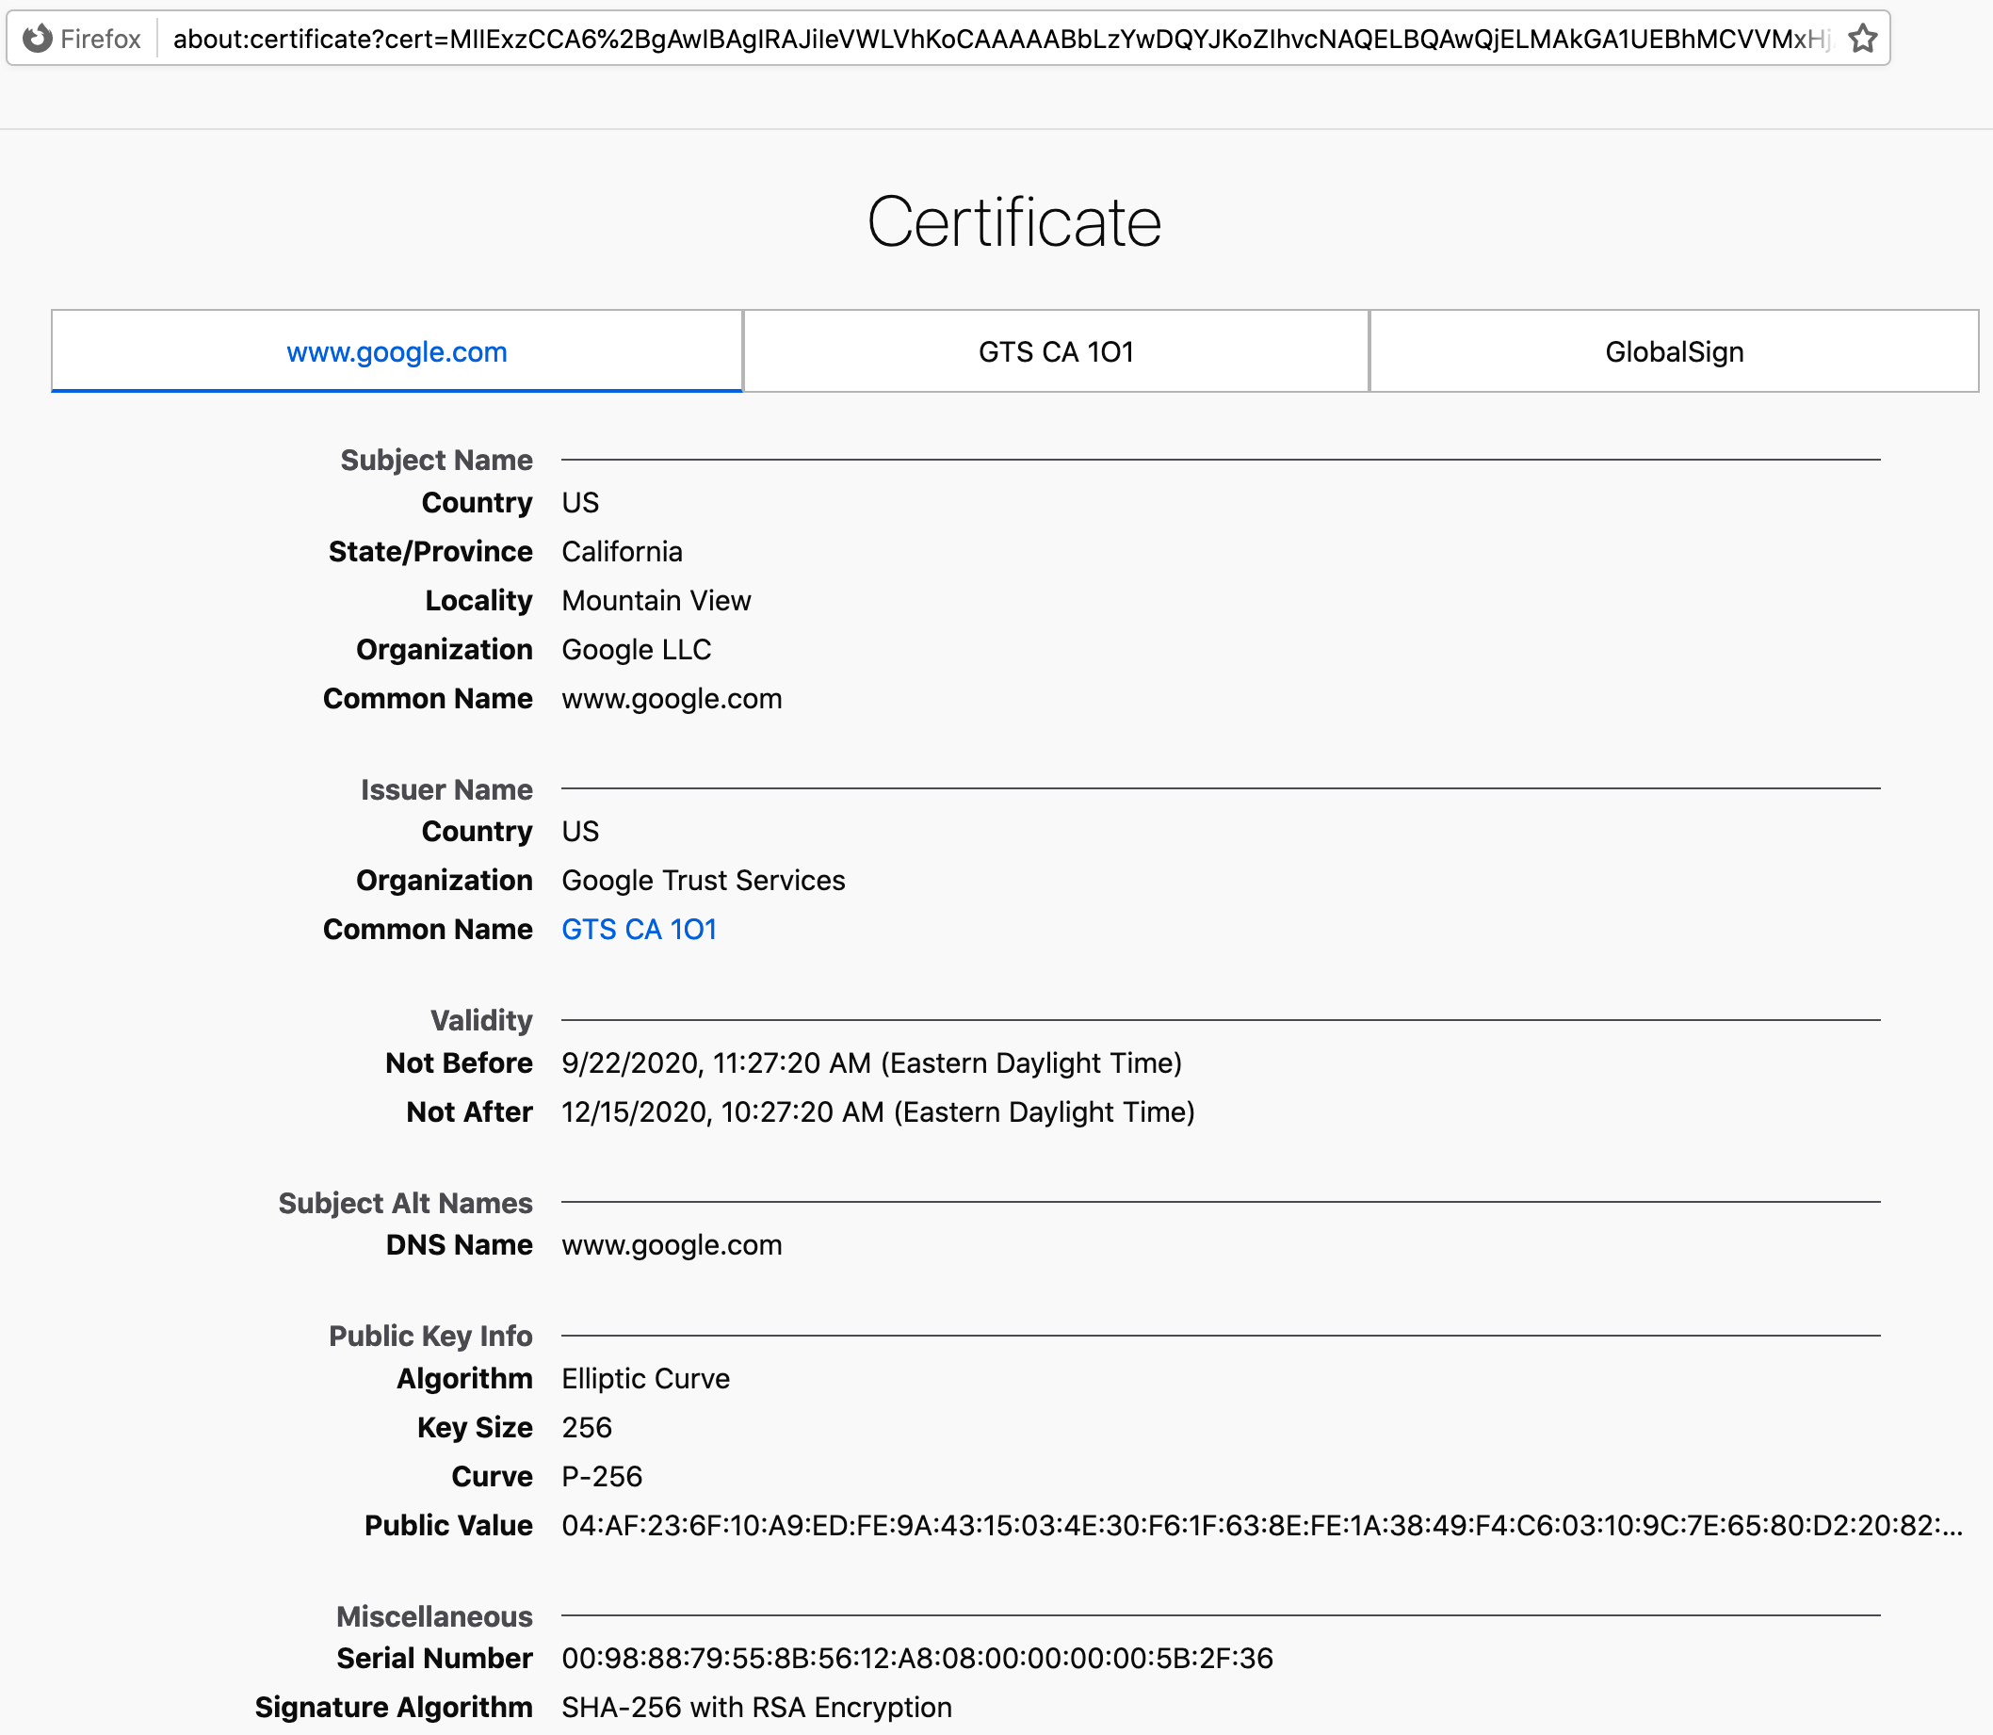

Slide 16
TLS or HTTPS Cartoonishly Oversimplified, Version 2
Secure Sockets Layer (SSL) or Transport-Layer Security (TLS), used in HTTPS (Secure HTTP), SSH, SCP, etc.
“TCP SYN, etc.”
“My public key is K.”**
“Encrypted secrets: {P}_{K} .”
Client
Server
[decrypts with private key]
…
** “Here is my certificate issued by somebody you trust stating that K is the public key of the server you want to reach.

Slide 17
Digital Signature
Goal: authenticate + validate integrity of a message M
Solution: take a hash digest h(M), encrypt it with B’s private key, and append it to M as a digital signature
Unforgeable. “Proves” that B created M.
Certified. “Proves” M has not been tampered.
Non-repudiable. B cannot deny creating M.
(But not private.)
Alice,
Will you marry me?
Signed, Bob

Slide 18
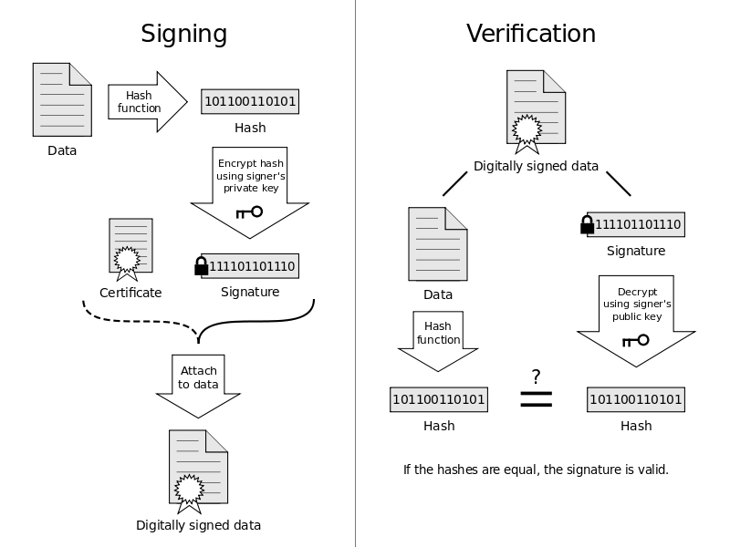
(optional)

Slide 19
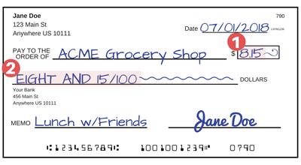
A key point
A digital signature is “stronger” than a physical signature, because it is bound to the contents of the message.
Any change to the contents yields a different hash value, which invalidates the signature.
An attacker cannot “fix” it without the issuer’s private key.

Slide 20
Certificates: a general view
A principal A delegates trust to another (B) by endorsing its public key as bound to a global name (or any other attribute).
A delegation is an assertion of fact by the issuer A, and is commonly issued as a certificate that is digitally signed by A.
In a standard x.509 identity cert (i.e., an “SSL cert”, issued by a PKI CA for Web), the attribute is a distinguished name.
e.g., “Bob” or “amazon.com”
PKI- CA: Public Key Infrastructure, Certifying Authority
Because the certificate is signed, a third party C can validate and use A’s statement about B, if C knows A’s public key and if C trusts A.
Trust management systems use certificates to encode other kinds of attributes and statements, e.g., arbitrary logic statements about B.
Certificate
Term of validity
Issuer’s name (or key)
Payload: statement
Signature

Slide 21
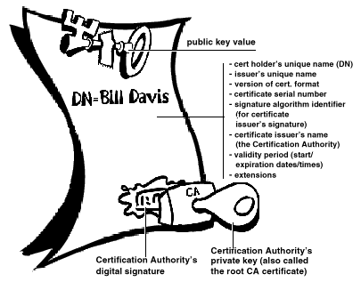
A Digital Certificate (X.509)

Slide 22
“It’s not hard”
public Identity(String cn) throws
CertificateException, NoSuchAlgorithmException,InvalidKeyException,
NoSuchProviderException, SignatureException, IOException {
X509V1CertificateGenerator gen = new X509V1CertificateGenerator();
kp = KeyPairGenerator.getInstance("RSA").genKeyPair();
gen.setIssuerDN(new X500Principal("CN=" + cn));
gen.setSubjectDN(new X500Principal("CN=" + cn));
gen.setNotAfter(new Date(System.currentTimeMillis()
+ 3600 * 1000 * 24 * 365));
gen.setNotBefore(new Date(System.currentTimeMillis()));
gen.setSerialNumber(BigInteger.valueOf(System.currentTimeMillis()));
gen.setPublicKey(kp.getPublic());
gen.setSignatureAlgorithm("SHA256WithRSAEncryption");
X509Certificate a = (X509Certificate) gen.generate(kp.getPrivate(), "BC");
init(a);
}

Slide 23
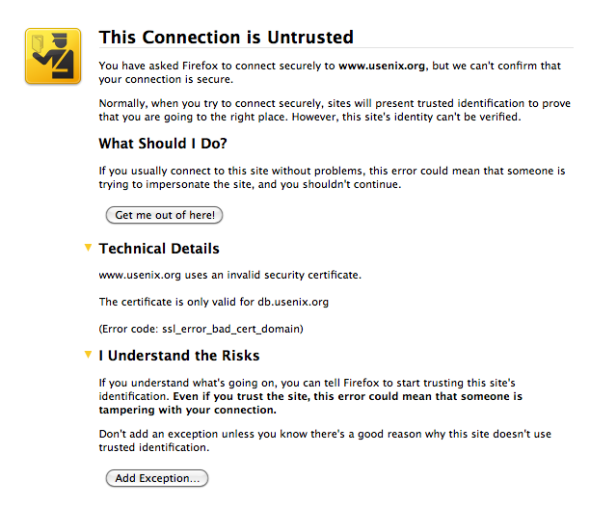

Slide 24
Take a breath Not quite done yet
With HTTPS, your browser can verify the server identity if it knows the “real” server’s public key.
The server presents a certificate endorsed by a third party (a public Certifying Authority or CA).
Certificate is the server’s “photo ID” containing its public key and DNS name, signed by the issuer.
Your browser can verify the certificate if it knows the issuer’s public key (the CA).
How does your browser know the CA’s public key?

Slide 25
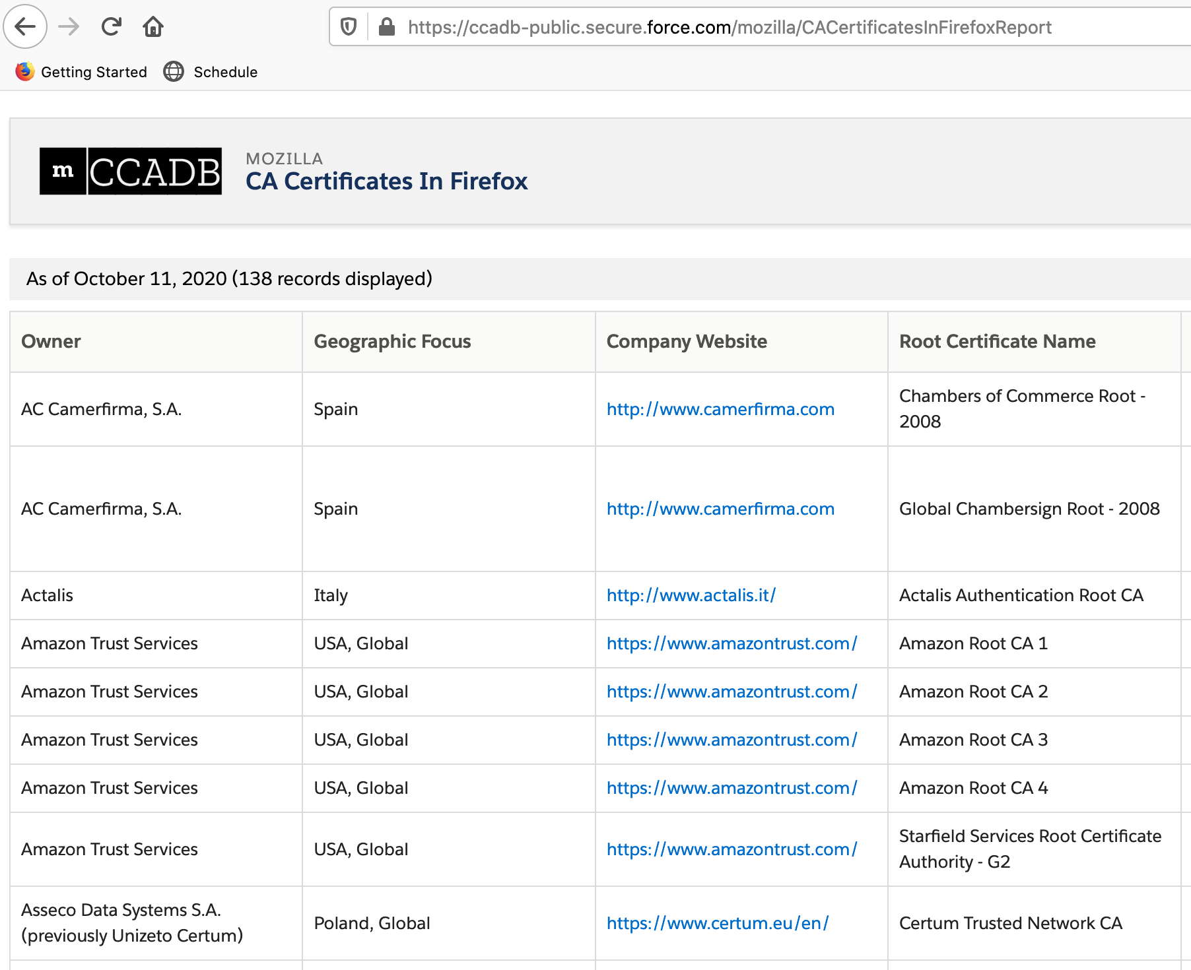
Who does your browser trust?

Slide 26
Browser CA list: what could go wrong?
The CA’s public key is “baked into your browser”.
Along with 137 (?) other “trusted” CAs.
You trust your browser provider to make the CA list.
Who is that? E.g., your cell provider, your employer, Apple or Microsoft, some random group on the Internet.
Any CA on the list can issue a certificate for any name and any public key: your browser believes it.
What could go wrong?

Slide 27
Who is the adversary?
2010

Slide 28
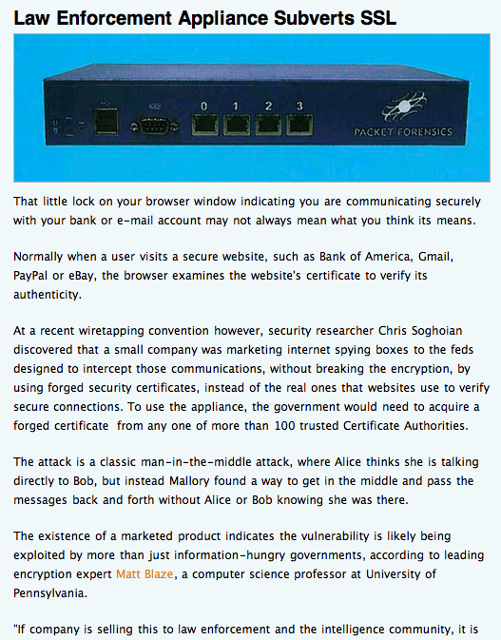

Slide 29
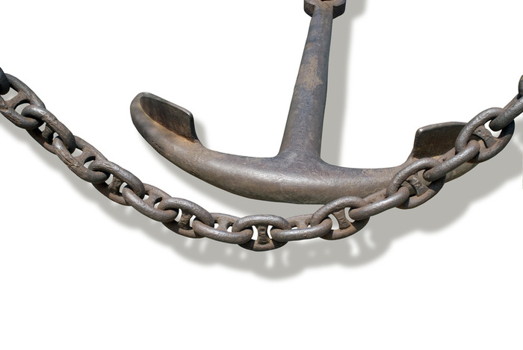
PKI: What could go wrong?
Who decides if a CA is “trustworthy”? Should you believe them? Should you trust your browser provider to make the list of trusted CAs?
Who tells you a CA is trustworthy? Are you sure it’s someone you trust? How can you can be sure that you have the "true" browser code with the "true" list?
What if they’re wrong? What if a CA is subverted or goes rogue? Or loses its private key in an attack?
We can learn about keys from a chain of endorsements rooted in some trust anchor, whose key we “just know”.
Example: root certifying authorities (CAs) whose keys are baked into your Web browser.

Slide 30
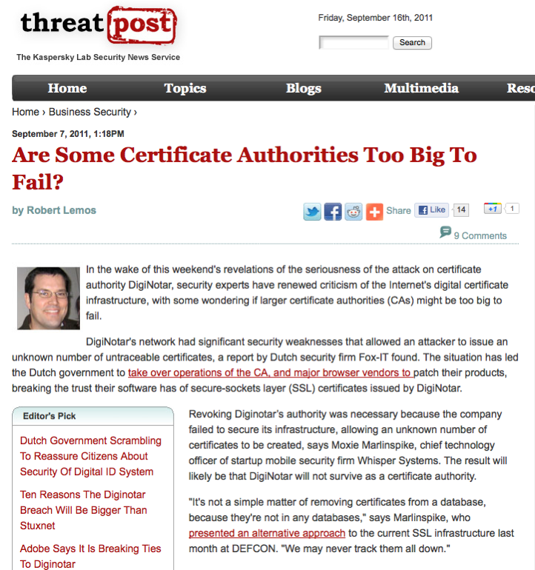

Slide 31
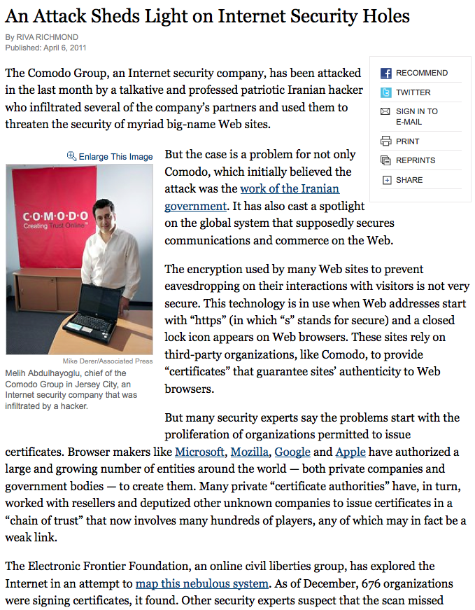

Slide 32
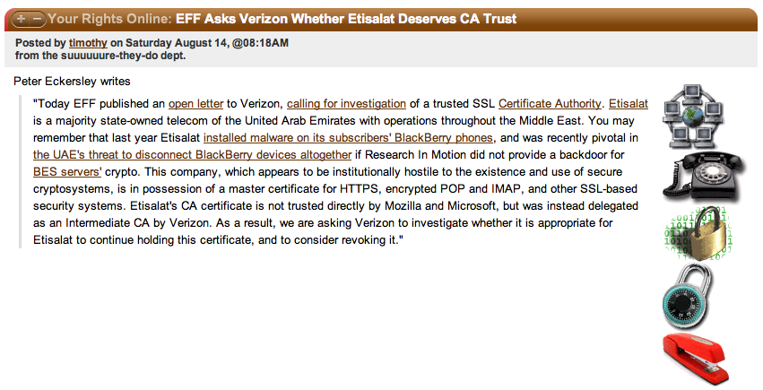

Slide 33
Spelling it out: HTTPS/SSL/TLS
When the server passes its public key K to the client, it also passes a certificate issued by a CA. The certificate endorses the key K and binds K to a DNS name (e.g., amazon.com). The server’s DNS name is listed as the “distinguished name” in its identity certificate.
The client’s browser validates the server’s certificate and checks to verify that the DNS name matches the DNS name in the https URL that the client is fetching. I.e., the certificate "proves" that the server is the "right" server for the requested URL.
The client can validate the server's certificate iff the client (browser) trusts the issuing CA. How does the client know if it trusts the issuing CA? Answer: the browser has a "baked in" list of trusted CAs and their public keys. The set of CAs and signing protocols and certificate standards (x.509 identity certificates) is called Public Key Infrastructure or PKI.
The client generates a session key and encrypts it with the server’s public key K, which it obtains from the cert. The session key is a secret shared by the client and server: the server can decrypt it (since it has the corresponding private key), but nobody else can.
Now the client and server have a shared secret session key: they can communicate using symmetric crypto, which is fast and cheap. [Note: modern TLS uses a more sophisticated key exchange for “forward secrecy”.]

Slide 34



Summary: relevant crypto
Generate a keypair.
Keep one key private.
The other key is public.
Use either key to encrypt.
Use the other to decrypt.
crypt
E
crypt
D
Use an open asymmetric (public-key) crypt function (e.g., ECDSA, RSA).
Combine with hashing (e.g., SHA256) to form digital signatures.
#
X
X
#
SHA256
SHA256
Message
Hash function
fixed-width
fingerprint
“Computationally infeasible”

